Slide 1

Quick ‘N Speedy Delivery
TEAM MEMBERS:​
S.J SUMANTH (2010030377)​
K. SREEVARUN (2010030451)​
E. PAVAN SAI (2010030538)​
E. SHIVA GOUD (2010030542)​
Under the guidance of
DEEPTHI KALAVALA

Slide 2

Outline
Abstract and problem statement
Algorithms
Flow Chart
GITHUB Commits
Work division

Slide 3
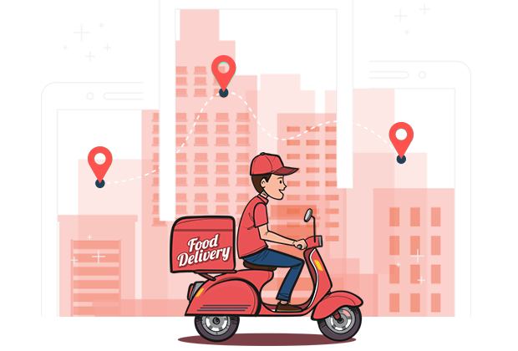
Abstract &PROBLEM STATEMENT
We have many food delivery apps like Swiggy, Zomato, Eat Sure etc.
Daily thousands of orders are made through these apps. In most cases, a driver should take more than one order at a time and deliver the same to respective customers in the given time.
So, in order to deliver all orders in the given time the delivery executive should choose the optimal path from source to destination.
He should delivery in time with minimum distance so he can save his time and get profit .

Slide 4
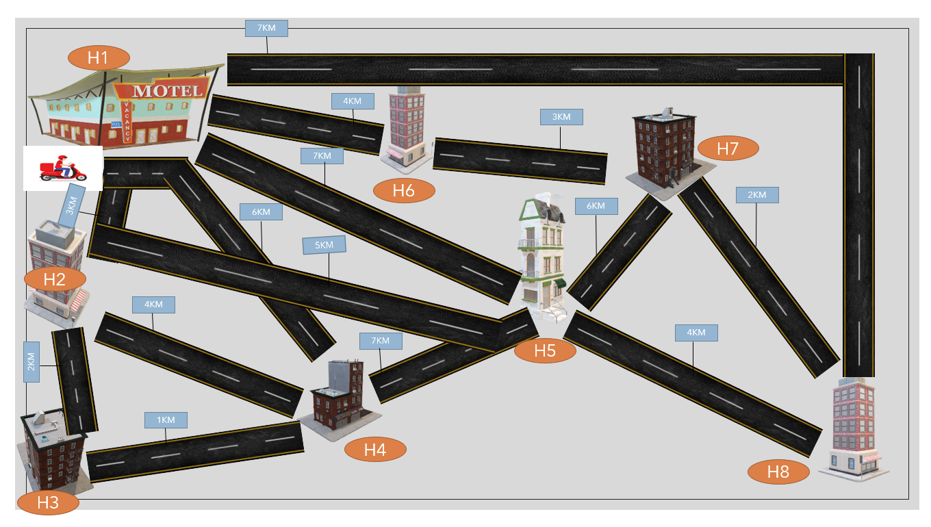

Slide 5

Problem Statement

Slide 6

What if There are n-Orders and m-delivery executives?

Slide 7


Slide 8
Algorithms

Slide 9
Ant Colony Optimization
Ant colony optimization (ACO) is a population-based metaheuristic that can be used to find approximate solutions to difficult optimization problems.
The solution construction process is stochastic and is biased by a pheromone model, that is, a set of parameters associated with graph components (either nodes or edges) whose values are modified at runtime by the ants.

Slide 10
Working of Ant Colony Optimization
First, each ant in the colony constructs a solution based on previously deposited pheromone trails.
Next ants will lay pheromone trails on the components of their chosen solution, depending on the solution’s quality.
An ant will often follow the strongest pheromone trail when constructing a solution.
However, for the ant to consider solutions other than the current best, a small amount of randomness is required in its decision process.
In addition to this, a heuristic value is also computed and considered helping to guide the search process towards the best solutions.
In the example of the multiple traveling salesman problem this heuristic will typically be the length of the edge between the destinations being considered - the shorter the edge, the more likely an ant will pick it.

Slide 11

Flow Chart

Slide 12
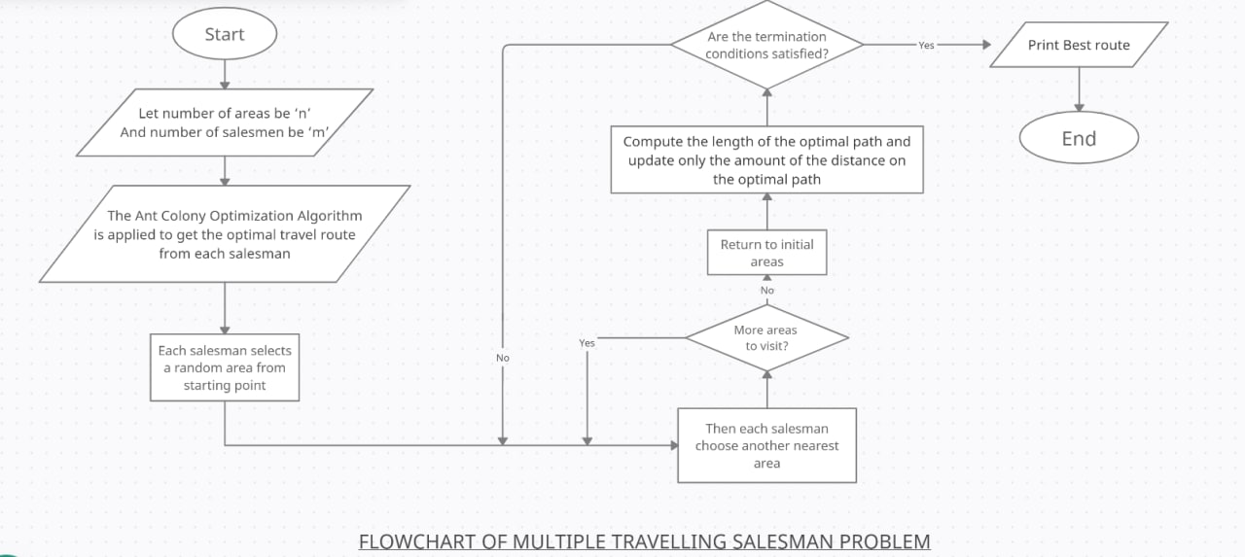

Slide 13
Implementation

Slide 14
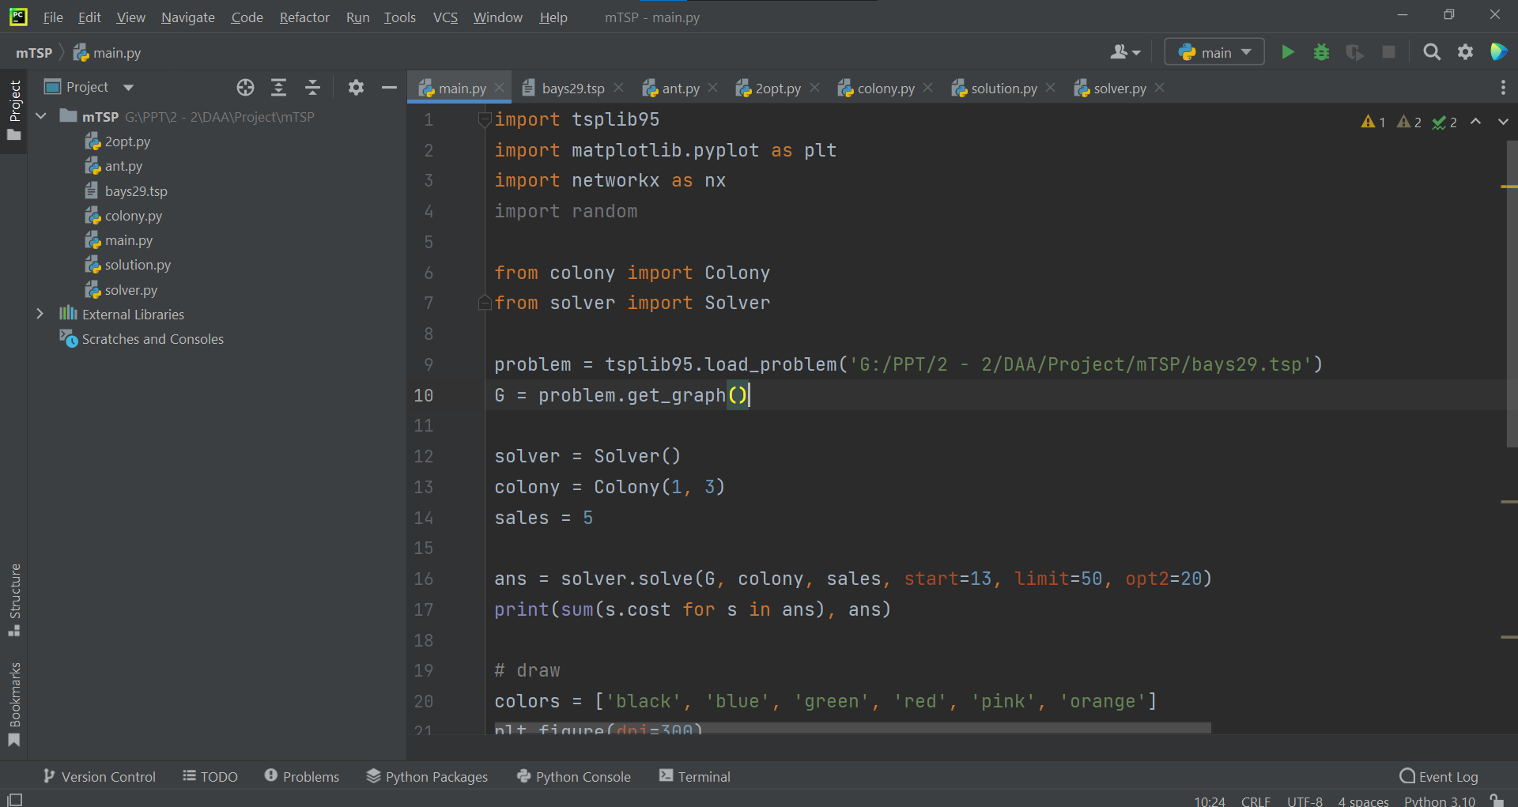

Slide 15
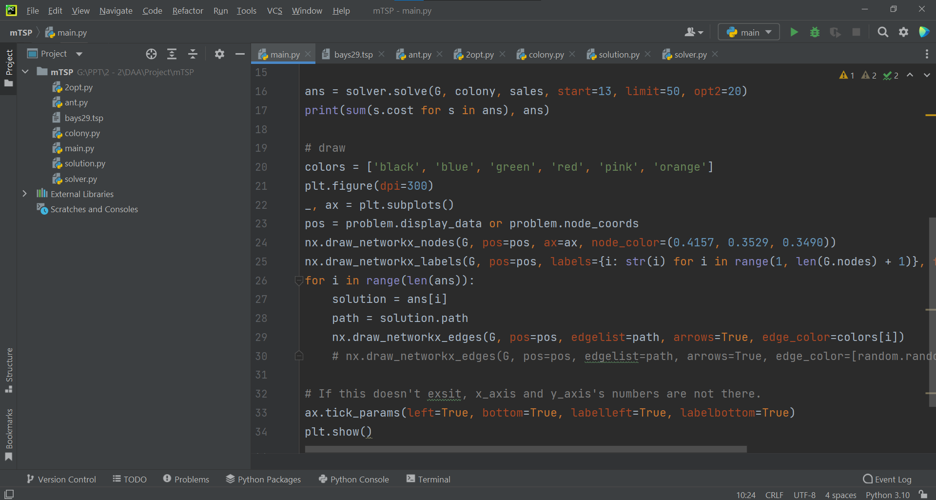

Slide 16

Results

Slide 17
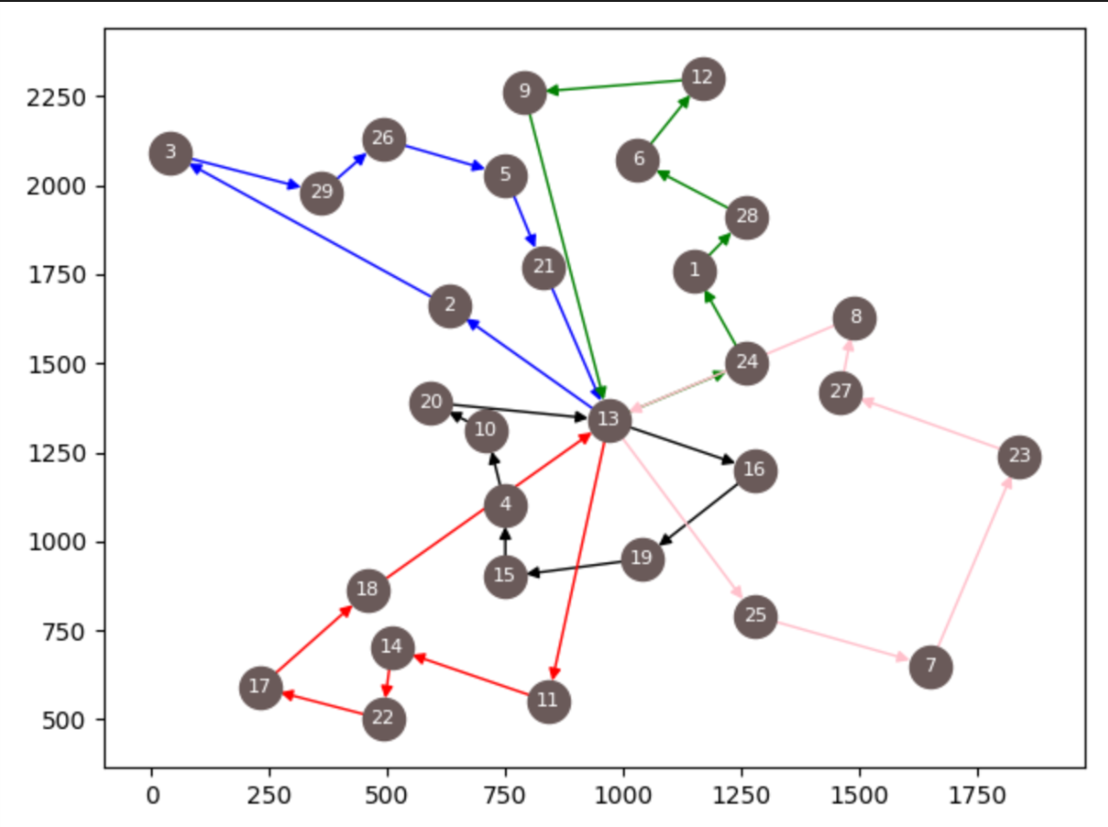

Slide 18
Future Scope
This procedure is not 100% accurate. So, in future we can improvise this algorithm and improve the accuracy.
We can combine multi-objective TSP with parallel processing. Parallel processing can improve algorithm speed and reduce algorithm execution time.

Slide 19


